Slide 1
ECONOMICS OF PATENT

Slide 2
INTRODUCTION
Patent is an exclusive right approved to a discoverer/inventor to have power over the use of an invention for a specific period.
Such rights authorizes a temporary monopoly to the inventor which is one of the way of rewarding inventive activity.
Monopoly is a market structure in which a product is supplied by a single firm.

Slide 3
ECONOMICS OF PATENTS
Figure 1: Determination of price & quantity
Patent is a source of monopoly
Patent grants the owner monopoly power to set the price above the cost of production
The more the difference between the cost of production and price, the more monopoly profit incurs
Under monopoly, the price and quantity of innovation is determined as shown in figure 1
OPm=monopoly price
OQm=monopoly quantity
OPc=competitive price
OQc=competitive quantity
Price of innovation
Pm
Pc
O
Qm
Qc
Innovation supplied
Source: Moschini (2004)

Slide 4
INVENTIONS & NATURAL MONOPOLY
Some inventions create natural monopoly (fall in average costs with increase in scale of production) as shown in fig. 2
Microsoft Corporation is the best example of natural monopoly enjoying huge monopoly profits.
PEFP’=monopoly profit
Price
AC
P
E
MC
P’
F
MR
D
Q
O
Quantity
Figure 2: Monopoly profit

Slide 5

BREADTH OF PATENT
Patent Breadth refers to a condition in which an awarded patent covers the field to which it pertains.
Broad Patent: Provides widest scope of protection but also present biggest target for validity challenges.
Narrow patent: It usually refers to precisely one exceptional invention
Broad patent facilitates original research and narrow patent encourages development.

Slide 6
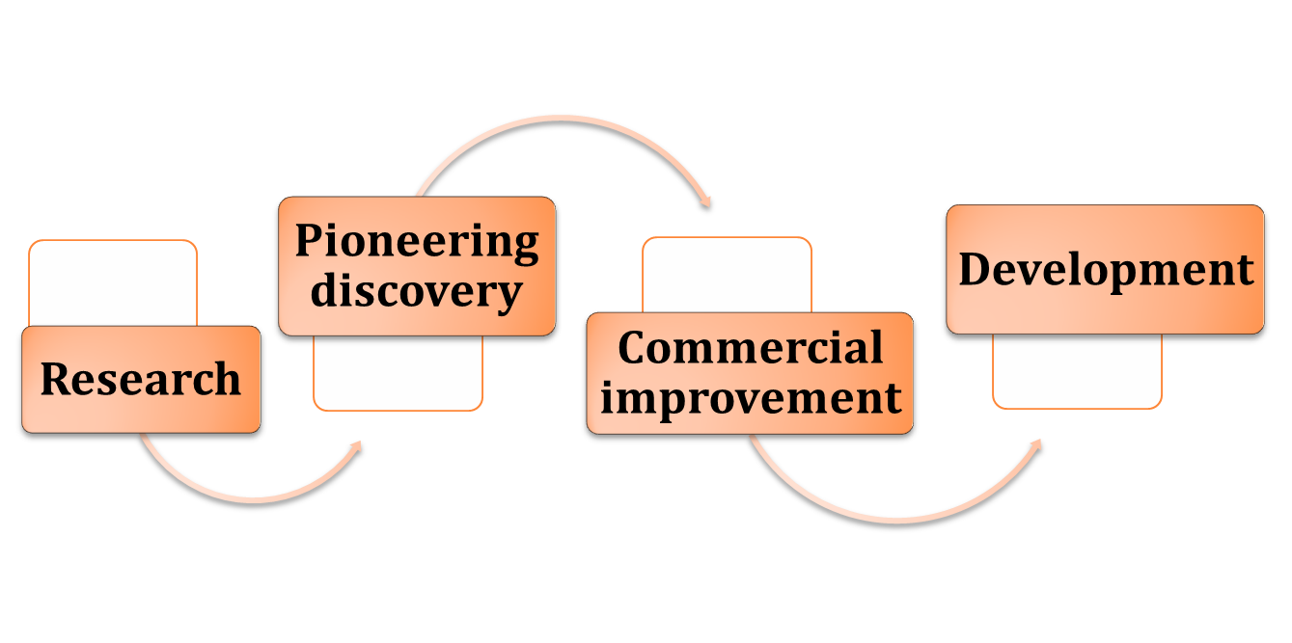
Process of Product Development

Slide 7
BREADTH OF PATENT….
Broader Patent
Narrow Patent
If social value of investment on research > the social value of investment on developing applications, patent should be broadened.
Patent protection should be broader for original inventions having little stand alone value.
If social value of investment on research < the social value of investment on developing applications, patent should be narrowed.
Patent protection should be narrower for original inventions having large stand alone value.

Slide 8
DURATION OF PATENT
It refers to numbers of years the patent has been granted to the owner.
Ideally there would be different patent duration for each invention.
It is obvious that with increase in duration, the inventor enjoys benefit of more innovation

Slide 9
DURATION OF PATENT
Duration of patent protection should be determined where marginal social benefits=marginal social costs (Nordhaus, 1969) as shown in fig. 3
MSB
MSC & MSB
Of
Patent
protection
E
MSC
t *
t(patent life in years)
Figure 3: Optimum Patent Life

Slide 10
ECONOMICS OF PATENT….
Patent rights deal with information related to inventions, innovations and technological improvement.
Public goods characteristics of information like non excludability and non rivalry leads to under supply of inventions or less than optimum level of invention which refers to market failure.

Slide 11
ECONOMICS OF PATENT….
Economics of innovation:
Patent protects and stimulates innovations and inventions.
by giving return on the innovator’s investment,
by disclosing knowledge and information.
It can be shown with the help of fig. 4.1
Patent impedes innovation :
by restricting use of knowledge,
by generating monopoly power,
by imposing short run costs,
by creating difficulties in the determination of boundaries
Thus patent may possibly discourage innovations and therefore reducing knowledge spillovers as shown in fig. 4.2

Slide 12
RELATIONSHIP BETWEEN IPR AND INNOVATION
POSITIVE RELATION
CONCAVE RELATION
Innovation and economic growth
Innovation and economic growth
Strength of patent protection
Strength of patent protection
Fig. 4.1
Fig. 4.2
Figure : Relation between IPR and innovation

Slide 13
PATENT AND ECONOMICS OF WELFARE
In case of patent protection, total welfare=DEGSm
In case of no patent protection, total welfare=DE’S
Whether stronger patent protection increases economic welfare or not?
Major aim of providing patent is to maximize welfare and to minimize losses.
The welfare effect of patent protection can be explained through a partial equilibrium as shown in the figure 5.
D
Sm’
E
P
Price
G
S’
E’
P’
Sm
s
M
Q
M’
D’
Quantity
Figure 5: Effect of patent protection on welfare
Source: Mukherjee (2015)

Slide 14
PATENT PROTECTION AND INTERNATIONAL TRADE
E= nash equilibrium
OQ= globally efficient patient
In an open economy, the determination of efficient patent protection is not simple because one country’s policy affects others (cross border externalities).
Grossman & Lai (2002) studied efficient patent protection in non-cooperative regime through model of Nash equilibrium as explained in the figure 6.
Tn
OM= harmonized patent
south best response function
Q
M
S
Nash
N
E
North best response function
O
S
N
Q
Ts
Figure 6 : Non co-operative and efficient patent protection

Slide 15
EMPIRICAL EVIDENCE
Example of east Asian countries like, Japan, South Korea & Hong Kong shows the positive effect of softer patent regime on welfare.
While, the experience of countries like, India, Brazil & South Africa shows the negative impact of TRIPS (greater protection) on economic well being.

Slide 16
ECONOMICS OF PATENT….
The trade off between the social benefits of improved innovation and the social costs of restricted uses of innovation determines the optimum level of patent protection.
Economic justification for patent protection:
Prevents free riding
It creates incentives for private entrepreneurs
Optimum allocation of resources
Optimum production of inventions
Prevents society to pay additional opportunity cost on the way of production
Checks market failure through externalities.

Slide 17
CONCLUSION
After explaining patent protection from economic point of view, we can say that it is an important tool for innovation and information.
The economic value of patent protection is to a large extent based on the economics of monopoly, information, innovation, welfare and trade.

Slide 18
FURTHER READINGS
Cooter, R. & Ulen, T. (2004). Laws & Economics. New Delhi: Pearson Education Pte. Ltd.
https://www.youtube.com/watch?v=DBmzjZ_hTQo&list=PLRkCJvWSrxbt-xBX5cjzTr4pE0SZ-pIOf&index=1
Nordhaus, W.D. (1969). Invention, Growth and Welfare: A Theoretical Treatment of Technological Change, Cambridge MA, The M.I.T. Press
Grossman G.M., & Helpman, E. ( 1991). Quality ladders in the theory of growth, Review of Economic Studies, 58, 43-61
Mukherjee D. (2015). TRIPS and the balance between private rights and public well being: The case of the pharmaceutical sector. Foreign trade review, 50(4), 284-297.

Slide 19
THANK YOU

